Slide 1
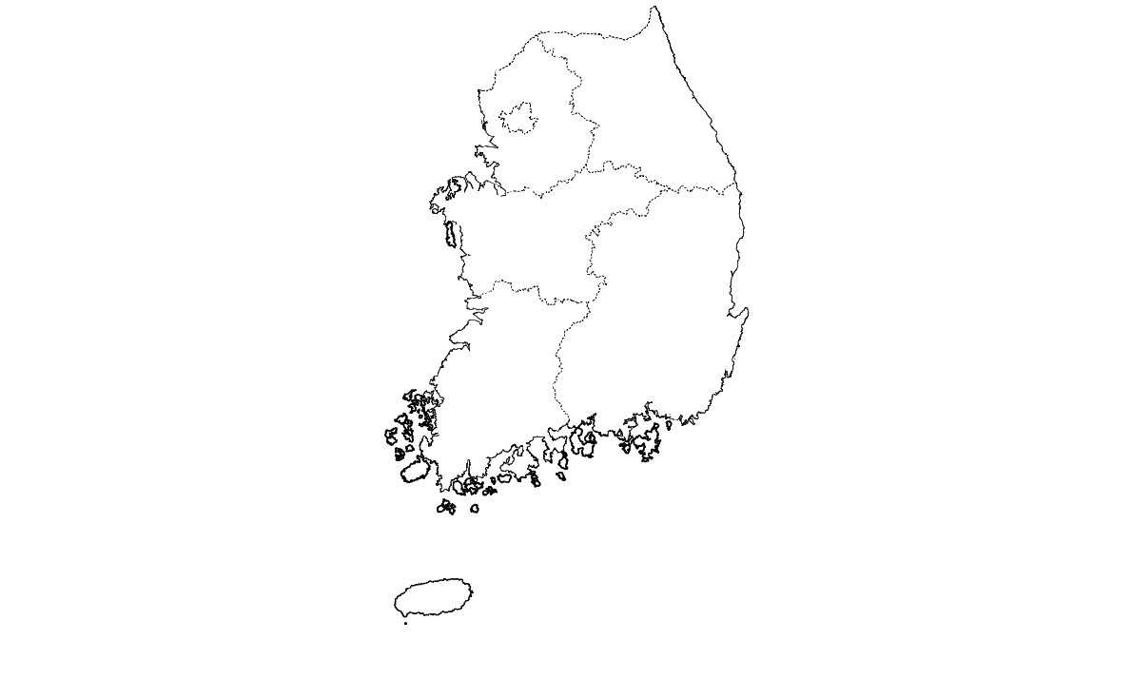
Fig. 1
Seoul:
35 SC (n=140), 220 HAC (n=880) and 221 VS (n=442) from 7 veterinary hospitals
Gangwon-do:
22 SC (n=88), 39 HAC (n=149) and 32 VS (n=64) from 2 veterinary hospitals
Gyeonggi-do:
78 HAC (n=266) and 4 VS (n=8) from 3 veterinary hospitals
Chungcheong-do:
10 HAC (n=50) and 10 VS (n=20) from 1 veterinary hospital
Gyeongsang-do:
20 SC (n=100) and 20 VS (n=40) from 3 veterinary hospitals
Jeolla-do:
3 HAC (n=12) and 6 VS (n=12) from 3 veterinary hospitals
0
50
100 km
Jeju-do:
1 SC (n=5) and 1 VS (n=2) from 1 veterinary hospital

Slide 2
Figure Legend
Fig. 1 Geographical distribution of veterinary hospitals included in this study. The map shows physical locations of veterinary hospitals in which samples collected (closed circles) and the number of samples collected in each province. The number in parentheses indicates the total number of swab samples collected from the indicated number of individual cats or staffs. SC, stray cats; HAC, hospital-admitted cats; VS, veterinary staffs. The map used in the figure was taken from the National Geographic Information Institute of Korea (https://www.ngii.go.kr/child/content.do?sq=149).

Slide 3
Fig. S1 (A)

Slide 4
Fig. S1 (B)
c
b
c
b
c
a
a
a
b
b
b
a
b
a
a
a
a
b
b
a
a
a
a
a

Slide 5
Fig. S1 (C)
c
b
b
a
a
a

Slide 6
Fig. S1 (D)

Slide 7
Additional file
Fig. S1 Percentage resistance for antimicrobials against Coagulase-positive Staphylococci (A), Coagulase-negative Staphylococci (B), Enterobacteriaceae (C), and Enterococcus spp. (D) isolates from stray cats, hospital-admitted cats, and veterinary staff. The data sets labeled with different superscript letters (a, b, and c) are statistically different from each other (P < 0.05).

